Slide 1

Stock Price Forecasting using LSTM and AzureML
Time Series Analysis using Deep Learning
Data 690: Financial Data Science (Special topic)
Dr. Abdullah Karasan
ShuvrajyotiDeb Roy Swetha Vadrevu

Slide 2
Introduction
Artificial intelligence (AI) and machine learning (ML) techniques has gained significant attention in the financial sector. In this project, we will utilize the LSTM model to predict the stock prices of various companies. By analyzing historical data and using the LSTM model to forecast future stock prices, we can potentially identify profitable investment opportunities.
The ability to accurately forecast stock prices is essential for investors and traders looking to make informed decisions. By using advanced ML techniques such as LSTM, we can potentially gain a competitive edge in the stock market and increase our chances of success.

Slide 3
Time Series Forecasting
Time series forecasting is a technique used to make predictions based on historical time series data. A time series is a sequence of data points recorded over time, typically at regular intervals. Examples of time series data include stock prices, weather patterns, and website traffic.
There are various methods for time series forecasting, including:
Simple moving average: This method takes the average of the previous “n” data points to forecast the next point.
Exponential smoothing: This method takes a weighted average of the previous data points, with more weight given to more recent data.
Autoregressive integrated moving average (ARIMA): This method models the time series data as a combination of autoregression (AR), differencing (I), and moving average (MA).
Seasonal ARIMA (SARIMA): This method is a variation of ARIMA that takes into account seasonal patterns in the data.
Prophet: This is a forecasting tool developed by Facebook that uses a combination of trend, seasonality, and holidays to forecast time series data.
Deep learning models: Neural networks such as recurrent neural networks (RNNs) and long short-term memory (LSTM) networks can also be used for time series forecasting.

Slide 4
LSTM (Long Short-Term Memory)
LSTM (Long Short-Term Memory) is a type of recurrent neural network (RNN) architecture that is commonly used for sequence modeling and time series forecasting.
The main advantage of LSTMs over traditional RNNs is their ability to handle long-term dependencies in the input sequence. This is achieved through a set of gates that control the flow of information within the LSTM cell, including the input gate, forget gate, and output gate.
The input gate controls the flow of information from the input to the cell state, the forget gate controls the amount of information to be forgotten from the previous cell state, and the output gate controls the flow of information from the cell state to the output.
LSTMs are trained using backpropagation through time (BPTT), which involves updating the weights of the network based on the error between the predicted output and the actual output at each time step.
LSTMs are useful in a variety of applications, including speech recognition, language modeling, and time series forecasting. In time series forecasting, LSTMs can be used to learn patterns in the historical data and predict future values based on those patterns.

Slide 5
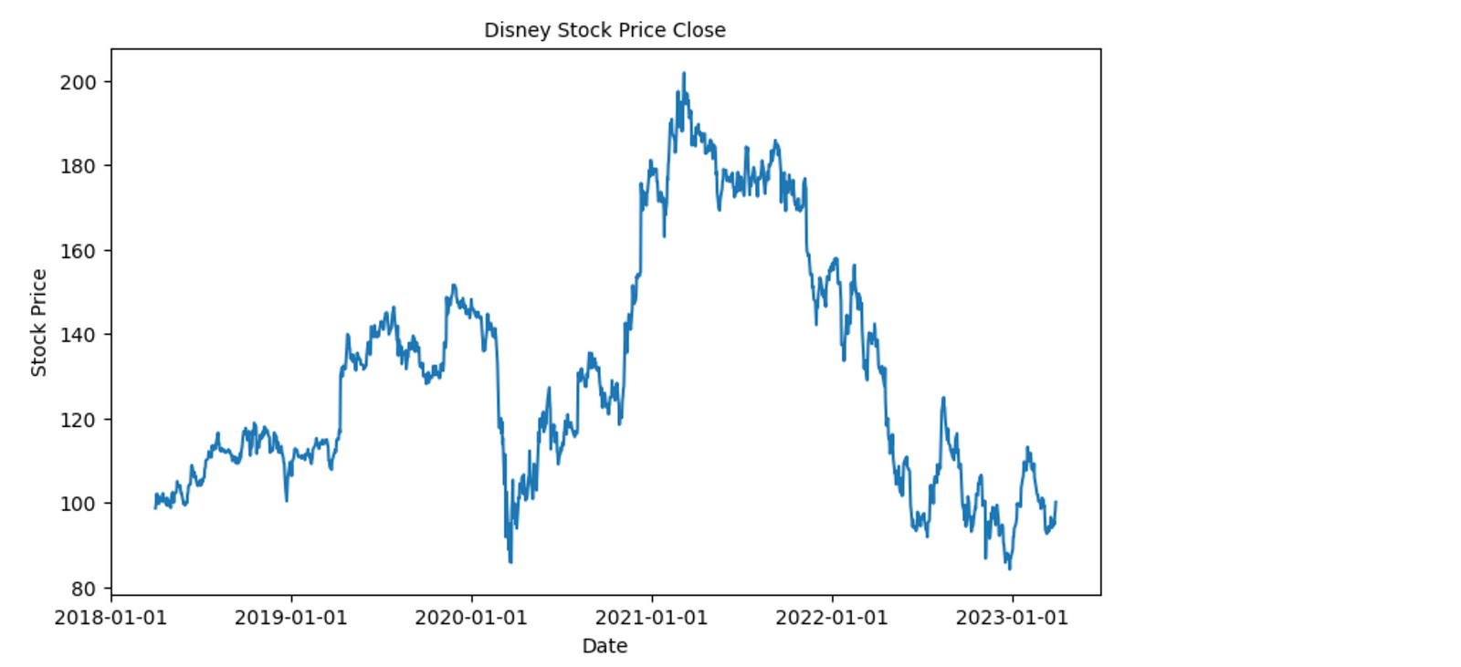
Plot Walt Disney Stock Price for last 5 years
The raw data in the stock price close data exhibits a certain pattern. Despite a decrease at the beginning of Q1 2020, there is a general upward trend, peak at the beginning of 2021 and again downward trend from the middle of 2021.

Slide 6
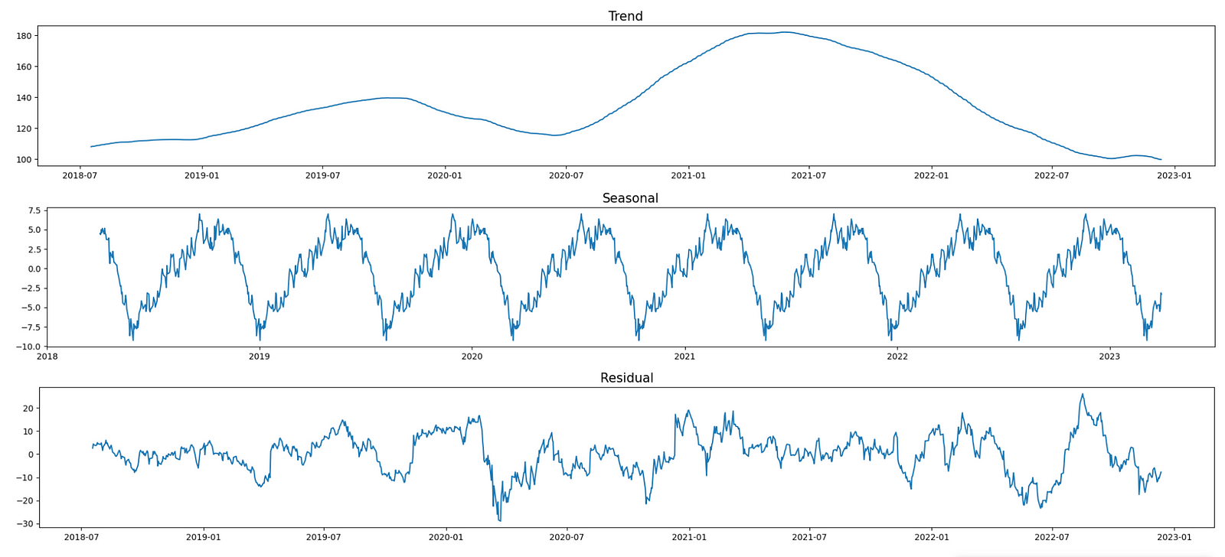
Trend, Seasonal and Residual

Slide 7
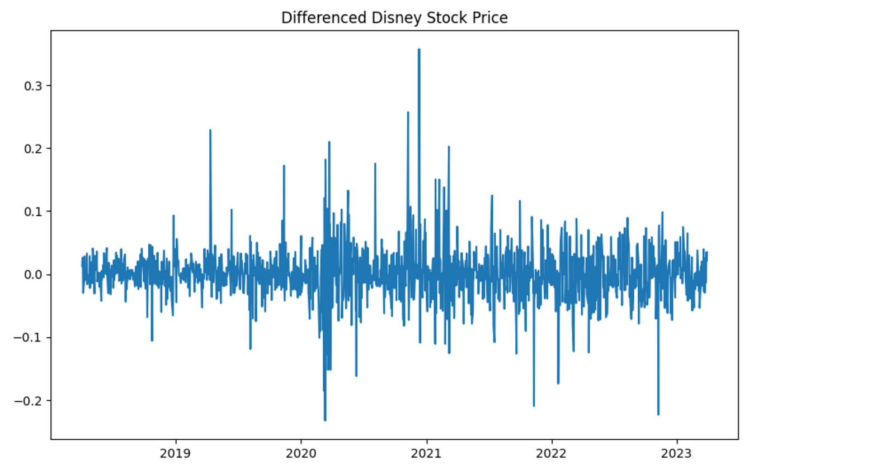
Stationarity of data using differences
Statistical properties of time series such as mean, variance should remain constant over time to call time series is stationary - constant mean, constant variance, autocovariance that does not depend on time. autocovariance is covariance between time series and lagged time series.

Slide 8
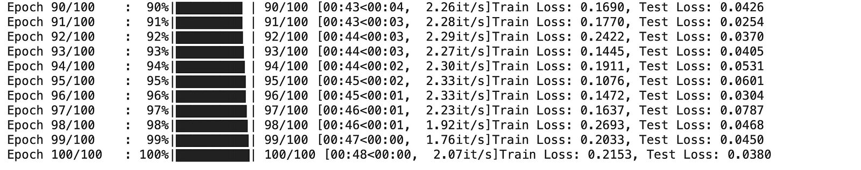
Training the LSTM model
Here, we are using 100 epochs for our model to train on the complete training dataset with a learning rate of 0.00005 and Mean Square Error to determine loss and AdamW to optimize our model. We have received very minimal test loss of 3%

Slide 9
Root Mean Square Error
Root Mean Square Error (RMSE) is used for evaluating the accuracy of time series forecasting models. The RMSE measures the difference between the predicted values and the actual values, and is calculated by taking the square root of the mean of the squared differences between the predicted and actual values.

Slide 10
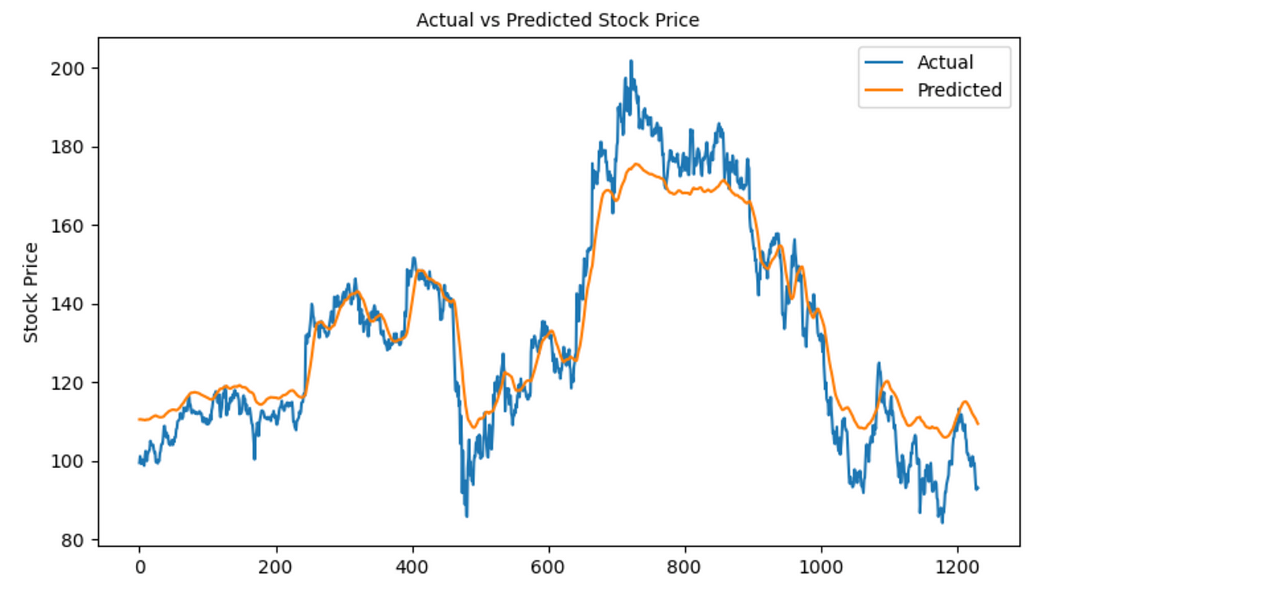
Actual Vs Predicted Results

Slide 11
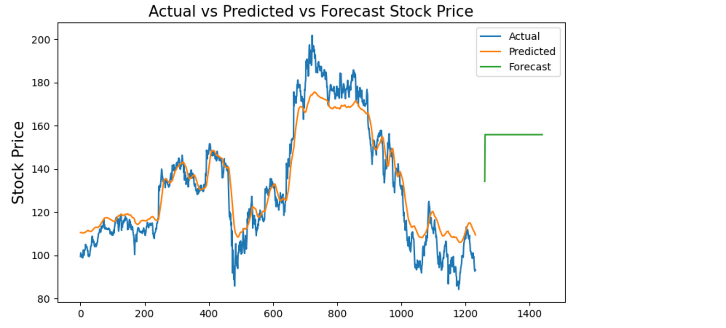
Actual Vs Predicted Vs Forecast Results

Slide 12
Future Scope
Optimization of LSTM model with hyperparameter tuning
Interactive Front-end webpage with dynamic and real-time stocks price forecasting
Azure Machine Learning implementation

Slide 13
Conclusion
In conclusion, the LSTM model offers great potential for forecasting stock prices and can be further optimized with the use of other techniques such as hyperparameter tuning, ensemble modeling, and data preprocessing techniques. The use of appropriate evaluation metrics, such as RMSE, is crucial to assess the performance of the model and compare it with other models.

Slide 14
References
P. (n.d.). examples/train.py at main · pytorch/examples. GitHub. https://github.com/pytorch/examples
Baquar, Z. (2023, February 9). Time Series Forecasting with Deep Learning in PyTorch (LSTM-RNN). Medium. https://towardsdatascience.com/time-series-forecasting-with-deep-learning-in-pytorch-lstm-rnn-1ba339885f0c
S. (n.d.). Azure Machine Learning documentation. Azure Machine Learning Documentation | Microsoft Learn. https://learn.microsoft.com/en-us/azure/machine-learning/
A. (n.d.). azureml-examples/pytorch_train.py at main · Azure/azureml-examples. GitHub. https://github.com/Azure/azureml-examples
Class notebooks

